Slide 1
Asset Allocation and Portfolio Management
R Davis
April, 2015

Slide 2
Topics Covered
Asset Allocation
The Ultimate Buy and Hold Strategy 2014
Alternate Allocations
Tools to Analyze and Monitor Portfolios

Slide 3
Asset Allocation

Slide 4
Investment Vehicles
Individual Stock & Bonds
  Advantages: No expenses, tax-efficient
  Disadvantages: Non-diversified, require study, splits & spinoffs
Mutual Funds – first traded in 1928
  Advantages: Diversification, dividend reinvestment
  Disadvantages: Expenses & charges, tax-inefficiency, end-of-day pricing
Exchange Traded Funds (ETFs) – first traded in 1993
Reference:
  http://arborinvestmentplanner.com/investment-vehicles-individual-stocks-bonds-mutual-funds-or-etfs/

Slide 5
Exchange Traded Funds (ETFs)
Advantages of ETFs
  Trading flexibility – can be bought and sold whenever markets open
  Diversification and Risk Management
  Lower Operation Costs (Expense Ratios)
  Tax Benefits
Disadvantages of ETFs
  Trading costs and bid and ask spread
  Tracking Error – main causes are illiquidity & transaction costs
  Complexity & Settlement Dates
References
  https://www.fidelity.com/learning-center/investment-products/etf/benefits-of-etfs
  https://www.fidelity.com/learning-center/investment-products/etf/drawbacks-of-etfs

Slide 6
Asset Allocation Models
References
  http://www.aaii.com/asset-allocation?adv=yes
  http://www.investopedia.com/articles/pf/05/061505.asp
  https://www.fidelity.com/managed-accounts/portfolio-advisory-service/asset-allocation-benefits
  https://intelligent.schwab.com/public/intelligent/insights/whitepapers/asset-allocation.html (white paper)
  http://www.vanguard.com/us/insights/saving-investing/model-portfolio-allocations
  http://paulmerriman.com/the-ultimate-buy-hold-strategy-2014/

Slide 7
The Ultimate Buy and Hold Strategy 2014
Paul Merriman’s Suggested Allocation

Slide 8
The Ultimate Buy and Hold Strategy 2014
Selected Disclaimers
  The articles and newsletters on this web site contain data gathered from sources that are believed to be reliable. However, we can make no representations as to their accuracy or completeness.
  Performance, as presented in charts, graphs, articles, etc. on this site, was calculated using hypothetical results. Although we have done our best to present this information fairly, hypothetical performance is still potentially misleading.
  Past performance may not be indicative of future results.
  [The information on this website] is not, and should not be construed, in any manner whatsoever, as the receipt of, or a substitute for advice from a investment professional.
  Reference: http://paulmerriman.com/the-ultimate-buy-hold-strategy-2014/

Slide 9
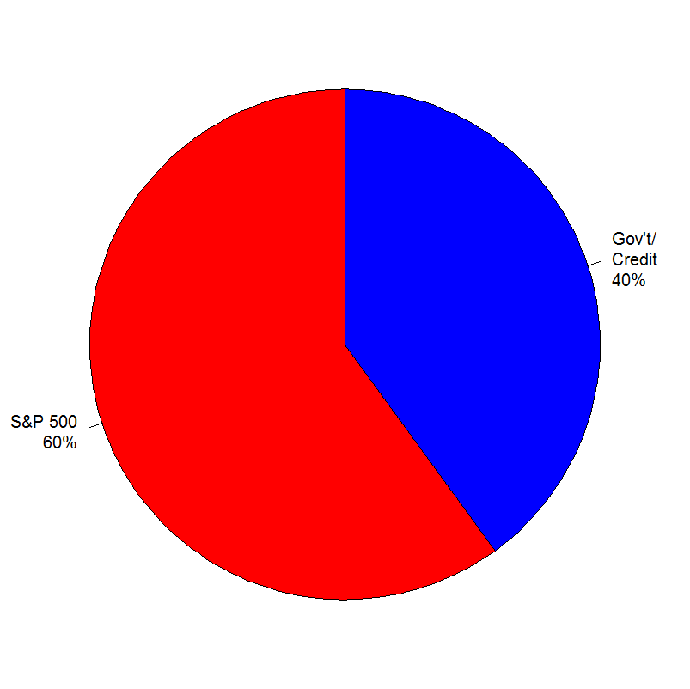
Step One: Start with the basics
Jan 1970 – Dec 2013 | Annualized Return | Annualized Std. Dev.
Step One: The basics | 8.8% | 11.3%
Initial (Jan 1970) | $100,000
Portfolio One | $4,069,110

Slide 10

Step Two: Modify bonds to all gov’t bonds
Jan 1970 – Dec 2013 | Annualized Return | Annualized Std. Dev.
Step One: The basics | 8.8% | 11.3%
Step Two: Modify bonds | 8.7% | 10.9%
Initial (Jan 1970) | $100,000
Portfolio Two | $3,849,488
Portfolio One | $4,069,110
Difference | ($219,622)

Slide 11
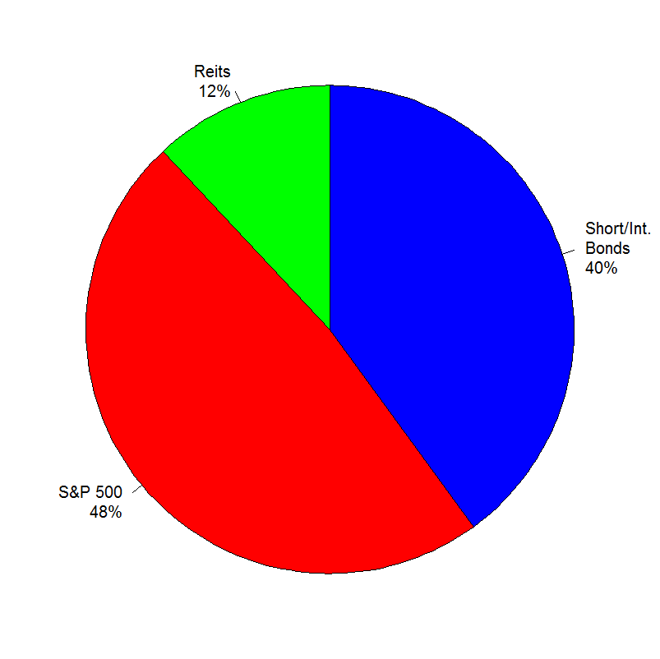
Step Three: Add real estate investment trusts
Jan 1970 – Dec 2013 | Annualized Return | Annualized Std. Dev.
Step One: The basics | 8.8% | 11.3%
Step Two: Modify bonds | 8.7% | 10.9%
Step Three: Add REITS | 8.8% | 10.4%
Initial (Jan 1970) | $100,000
Portfolio Three | $4,030,581
Portfolio One | $4,069,110
Difference | ($38,529)

Slide 12
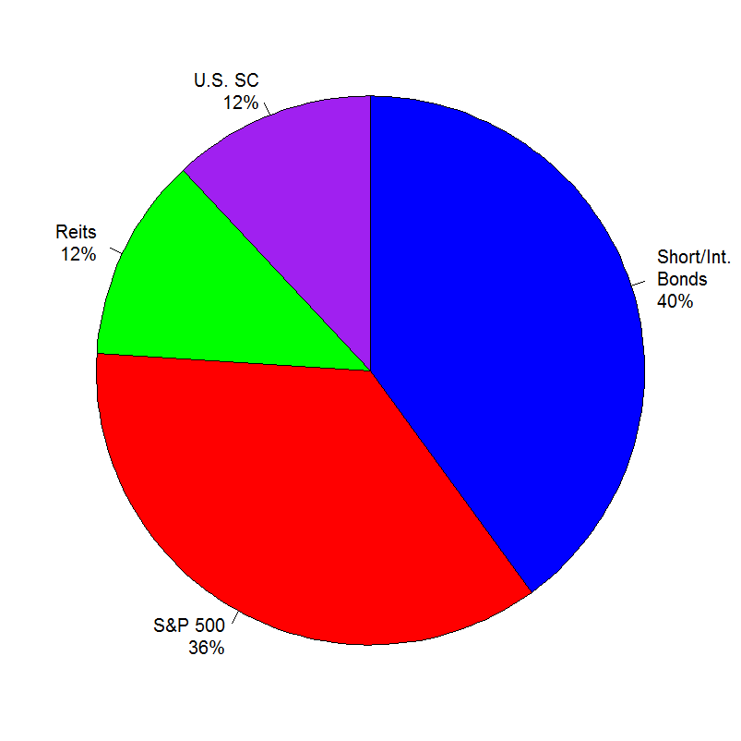
Step Four: Add small-cap stocks
Jan 1970 – Dec 2013 | Annualized Return | Annualized Std. Dev.
Step One: The basics | 8.8% | 11.3%
Step Two: Modify bonds | 8.7% | 10.9%
Step Three: Add REITS | 8.8% | 10.4%
Step Four: Add small-cap | 8.9% | 10.8%
Initial (Jan 1970) | $100,000
Portfolio Four | $4,334,554
Portfolio One | $4,069,110
Difference | $265,444

Slide 13
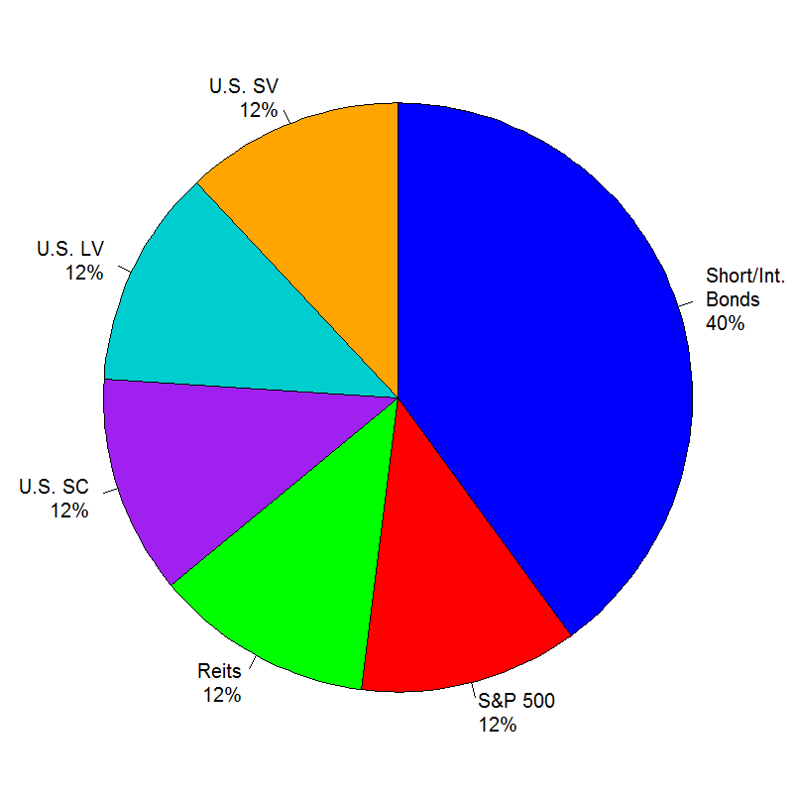
Step Five: Add value stocks
Jan 1970 – Dec 2013 | Annualized Return | Annualized Std. Dev.
Step One: The basics | 8.8% | 11.3%
Step Two: Modify bonds | 8.7% | 10.9%
Step Three: Add REITS | 8.8% | 10.4%
Step Four: Add small-cap | 8.9% | 10.8%
Step Five: Add value | 9.9% | 10.7%
Initial (Jan 1970) | $100,000
Portfolio Five | $6,471,301
Portfolio One | $4,069,110
Difference | $2,402,191

Slide 14
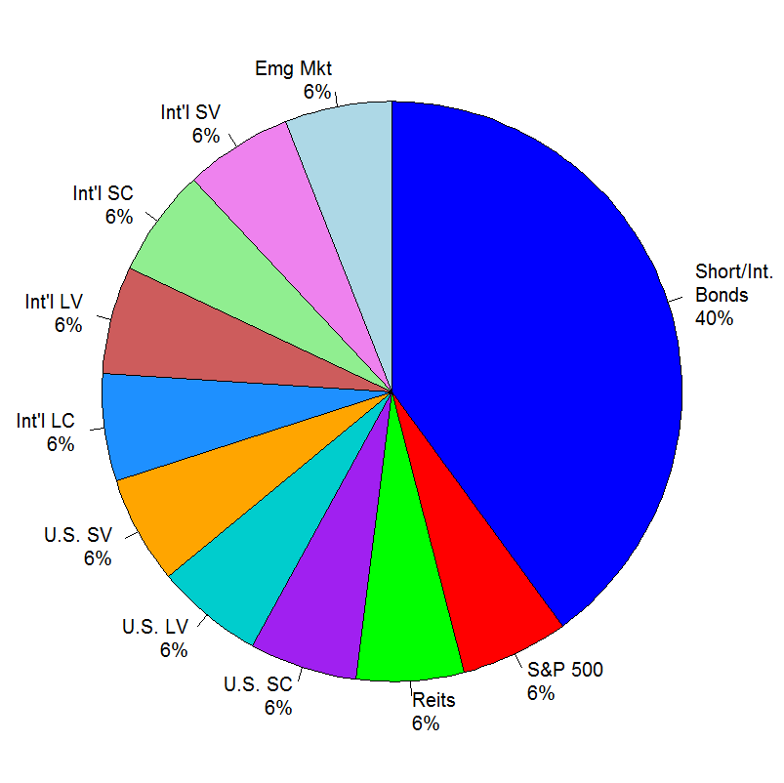
Step Six: Go global
Jan 1970 – Dec 2013 | Annualized Return | Annualized Std. Dev.
Step One: The basics | 8.8% | 11.3%
Step Two: Modify bonds | 8.7% | 10.9%
Step Three: Add REITS | 8.8% | 10.4%
Step Four: Add small-cap | 8.9% | 10.8%
Step Five: Add value | 9.9% | 10.7%
Step Six: Go global | 10.5% | 11.2%
Initial (Jan 1970) | $100,000
Portfolio Six | $8,164,368
Portfolio One | $4,069,110
Difference | $4,095,358

Slide 15
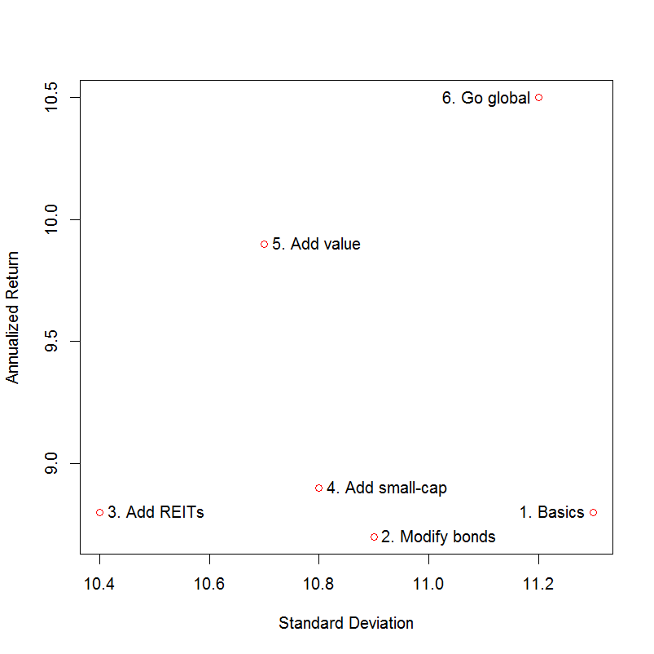
Risk and Return of Investment Steps
# R code which generates the scatterplot
return <- c( 8.8, 8.7, 8.8, 8.9, 9.9,10.5)
stddev <- c(11.3,10.9,10.4,10.8,10.7,11.2)
pos <- c(2, 4, 4, 4, 4, 2)
label <- c("1. Basics", "2. Modify bonds",
"3. Add REITs", "4. Add small-cap",
"5. Add value", "6. Go global")
plot(return ~ stddev, col="red",
xlab="Standard Deviation",
ylab="Annualized Return")
text(return ~ stddev, labels=label, cex=1,
pos=pos, offset=0.4)

Slide 16
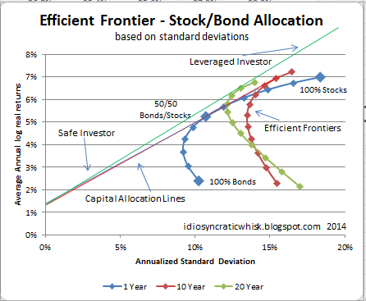
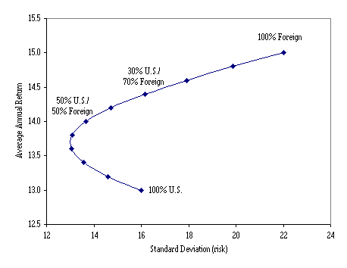
Efficient Frontier
Concept of modern portfolio theory introduced by Harry Markowitz and others in 1952.
http://idiosyncraticwhisk.blogspot.com/2014/03/stockbond-asset-allocation-part-3-short.html
http://www.swapmeetdave.com/Bible/USForeign.htm

Slide 17
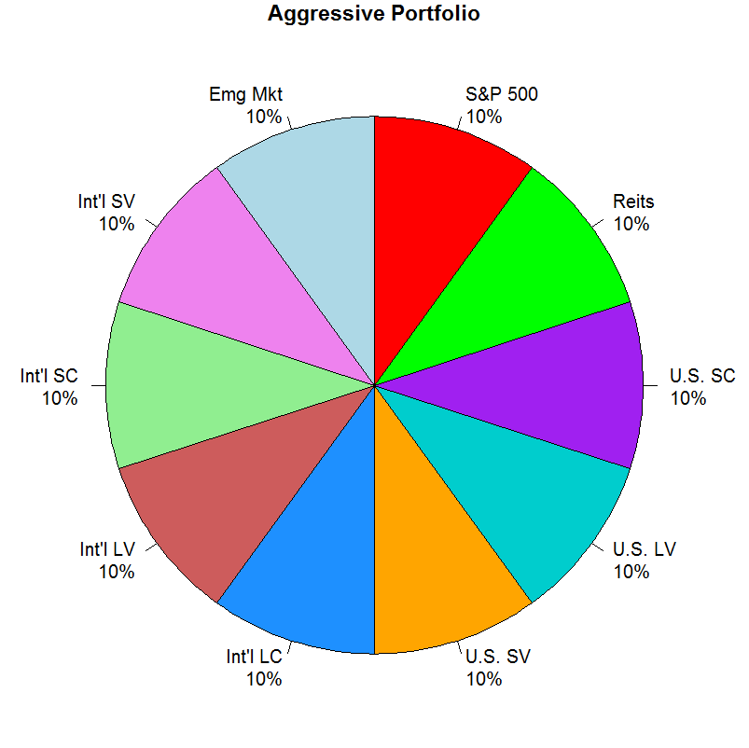
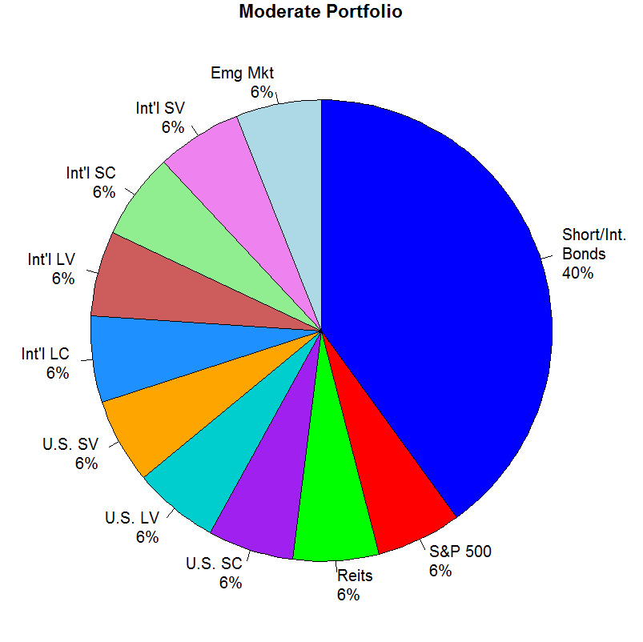
Aggressive vs. Moderate Portfolio

Slide 18
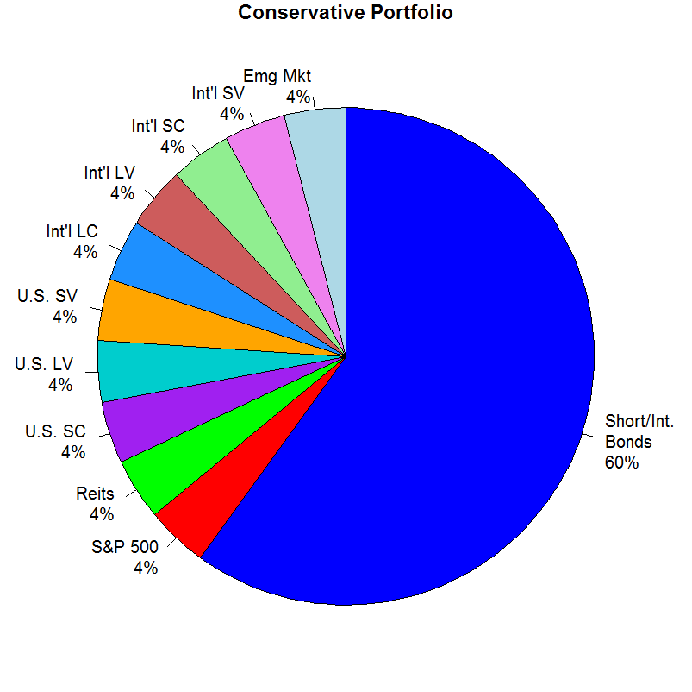
Moderate vs Conservative Portfolio

Slide 19
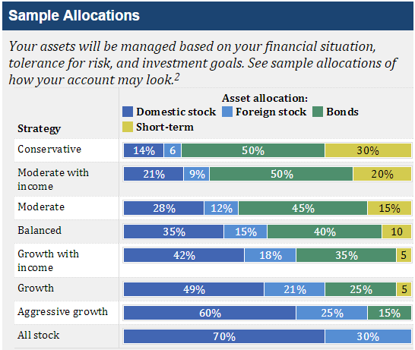
Alternate Allocations – Fidelity Investments https://www.fidelity.com/managed-accounts/portfolio-advisory-service/asset-allocation-benefits

Slide 20
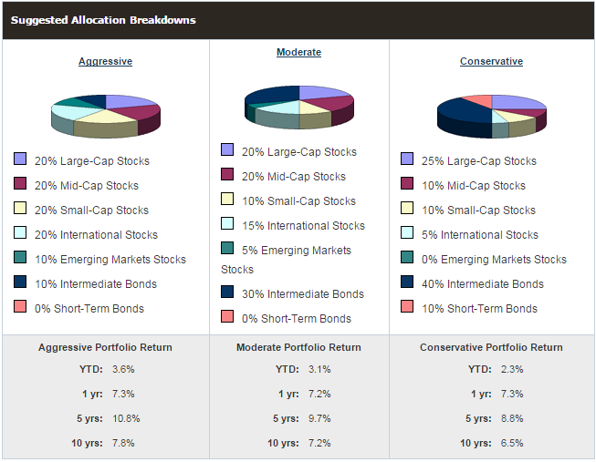
American Association of Individual Investors (AAII) http://www.aaii.com/asset-allocation?adv=yes

Slide 21
Schwab Tax-Deferred ETF Portfolios http://paulmerriman.com/schwab-tax-deferred-etf-portfolios/
ETF | Symbol | Aggressive | Moderate | Conservative
Schwab Large-Cap | SCHX | 10% | 6% | 4%
Schwab U.S. Large-Cap Value | SCHV | 10% | 6% | 4%
Schwab U.S. Small-Cap | SCHA | 10% | 6% | 4%
SPDR S&P 600 S-C Value | SLYV | 10% | 6% | 4%
Schwab U.S. REIT | SCHH | 10% | 6% | 4%
Schwab Intl Equity | SCHF | 10% | 6% | 4%
SPDR S&P Intl Dividend | DWX | 10% | 6% | 4%
Schwab Intl Sm-Cp Equity | SCHC | 20% | 12% | 8%
Schwab Emerging Mkt Eq | SCHE | 5% | 3% | 2%
SPDR S&P Emerging Mkts Sm-Cp | EWX | 5% | 3% | 2%
Schwab S-T U.S. Treasury | SCHO | 0% | 12% | 18%
Schwab I-T U.S. Treasury | SCHR | 0% | 20% | 30%
Schwab U.S. TIPS | SCHP | 0% | 8% | 12%

Slide 22
Market-Cap Index ETF Expenses http://www.schwab.com/public/schwab/investing/accounts_products/investment/etfs/schwab_etfs/market_cap_index_etfs
 | Schwab | Expense | Vanguard | Expense | iShares | Expense
Multi-Cap Core | SCHB | 0.04% | VTI | 0.05% | USMV | 0.15%
Large-Cap Core | SCHX | 0.04% | VV | 0.09% | ITOT | 0.07%
Large-Cap Growth | SCHG | 0.07% | VUG | 0.09% | QUAL | 0.15%
Large-Cap Value | SCHV | 0.07% | VTV | 0.09% | IVE | 0.18%
Equity Income | SCHD | 0.07% | VIG | 0.10% | HDV | 0.12%
Mid-Cap Core | SCHM | 0.07% | VO | 0.09% | IJH | 0.12%
Small-Cap Core | SCHA | 0.08% | VB | 0.09% | IJR | 0.12%
Real Estate | SCHH | 0.07% | VNQ | 0.10% | ICF | 0.35%
Core Bond | SCHZ | 0.05% | BND | 0.08% | AGG | 0.08%
Inflation Protected Bond | SCHP | 0.07% | VTIP | 0.10% | STIP | 0.10%
Short Term U.S. Treasury | SCHO | 0.08% | N/A |  | SHY | 0.15%
General U.S. Treasury | SCHR | 0.09% | EDV | 0.12% | IEI | 0.15%
Int’l Multi-Cap Core | SCHF | 0.08% | VEA | 0.09% | IEFA | 0.12%
Int’l Small/Mid-Cap Core | SCHC | 0.18% | VSS | 0.19% | SCZ | 0.40%
Emerging Markets | SCHE | 0.14% | VWO | 0.15% | IEMG | 0.18%

Slide 23
ETFs and Taxes http://www.schwab.com/public/schwab/nn/articles/ETFs-and-Taxes-What-You-Need-to-Know
Type of ETF or ETN | Categories | Maximum Low | Maximum High | Notes
Stock or bond ETF | Long/Short-term | 23.8% | 43.4%
Precious metal ETF | Long/Short-term | 31.8% | 43.4% | Collectible
Commodity ETF (limited partnership) | 60/40 | 23.8% | 43.4% | K-1*
Currency ETF (open-end fund) | Long/Short-term | 23.8% | 43.4%
(grantor trust) | Ordinary Income | N/A | 43.4%
(limited partnership) | 60/40 | 23.8% | 43.4% | K-1*
Stock or bond ETN | Long/Short-term | 23.8% | 43.4%
Commodity ETN | Long/Short-term | 23.8% | 43.4%
Currency ETN | Ordinary Income | N/A | 43.4%
* ETFs that issue a K-1 form:
http://etfdb.com/etf-tax-efficiency/etf-tax-tutorial-complete-list-of-etfs-that-issue-a-k-1/

Slide 24
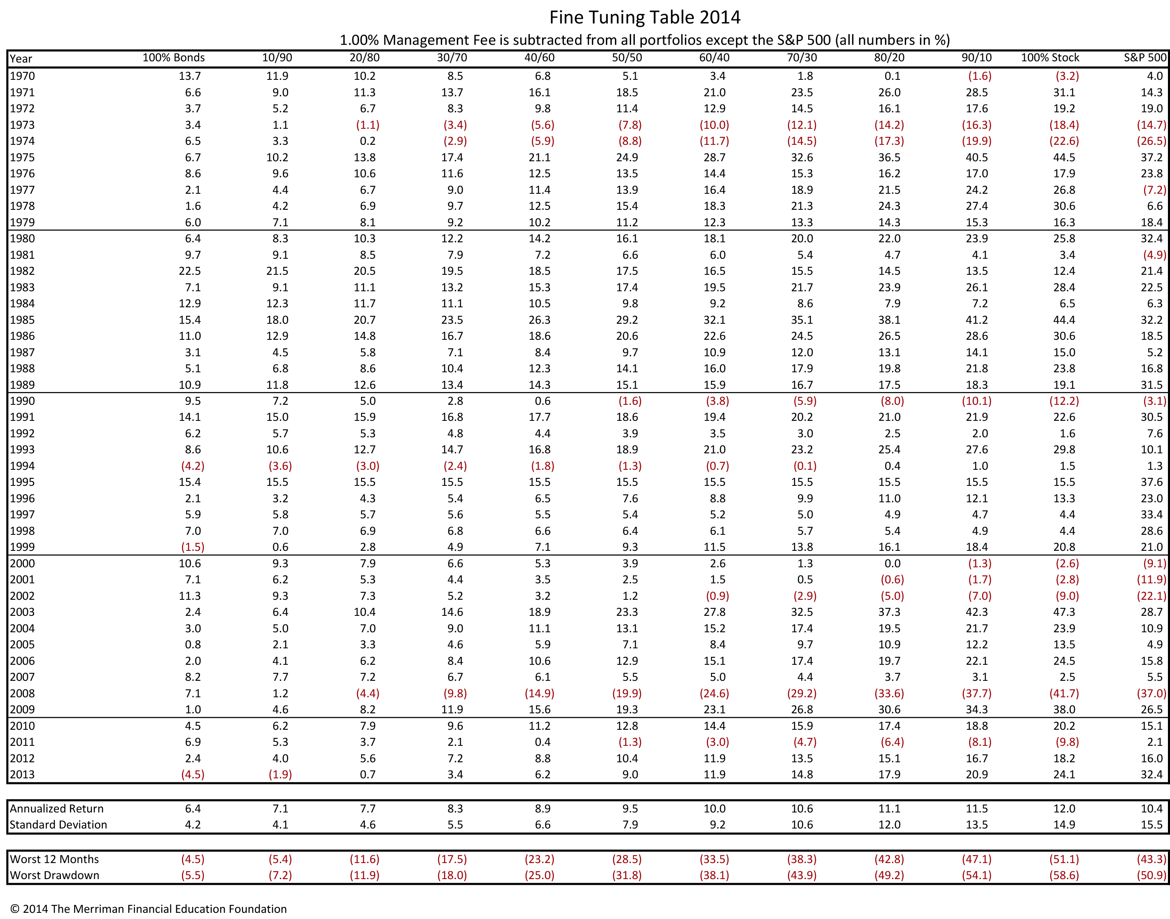
Fine Tuning Your Asset Allocation 2014 http://paulmerriman.com/fine-tuning-your-asset-allocation-2014/

Slide 25
Tools to Analyze and Monitor Portfolios

Slide 26
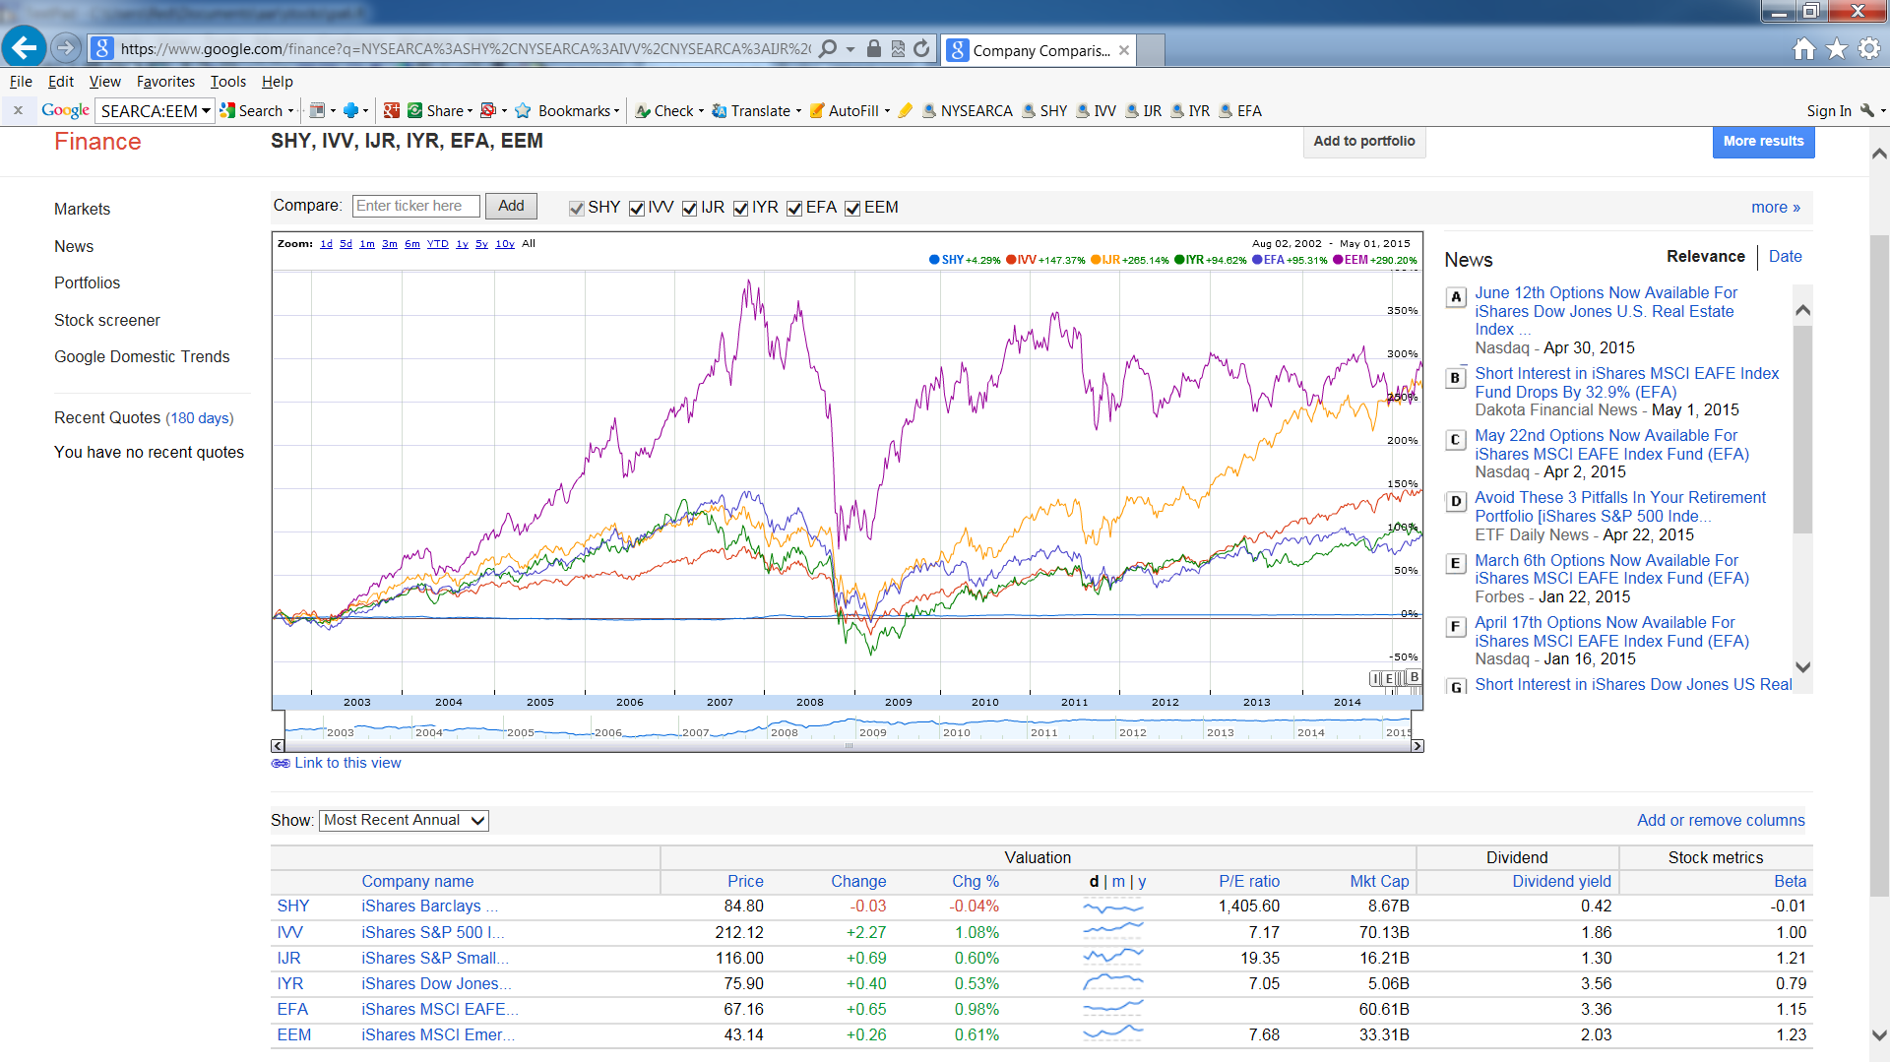
Sample Portfolio in Google Finance https://www.google.com/finance?q=NYSEARCA%3ASHY%2CNYSEARCA%3AIVV%2CNYSEARCA%3AIJR%2CNYSEARCA%3AIYR%2CNYSEARCA%3AEFA%2CNYSEARCA%3AEEM&ei=Gt5GVen3LsjKiwKJ54D4Dw

Slide 27
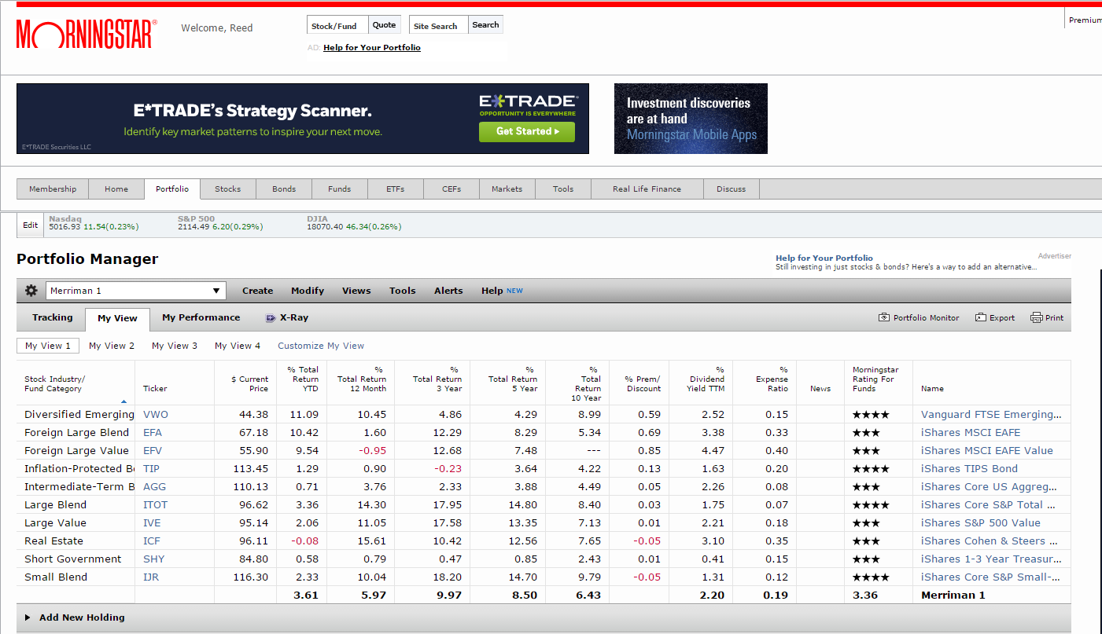
Sample Portfolio in Morningstar http://portfolio.morningstar.com/

Slide 28
Using R to Analyze Portfolios
R is a free software environment for statistical computing and graphics. It also has numerous packages for stock analysis and portfolio management.
The quantmod package is designed to assist the creation of trading models but can also download the open, high, low, close, volume, and adjusted price since 2007.
The two graphs on the following page show the importance of looking at prices that have been adjusted for dividends and splits. For example, the large difference in EEM is due to a 3-for-1 split that occurred in EEM on July 23, 2008. On that date, holders of EEM received 2 shares for every one owned but the price of stock dropped to one-third of its value.

Slide 29
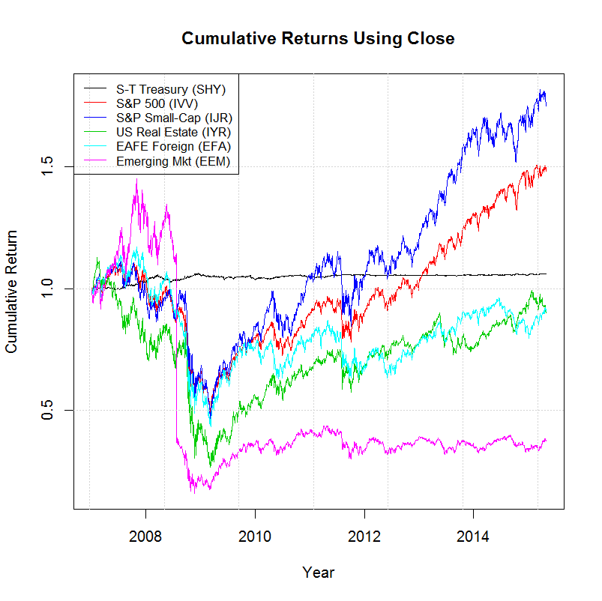
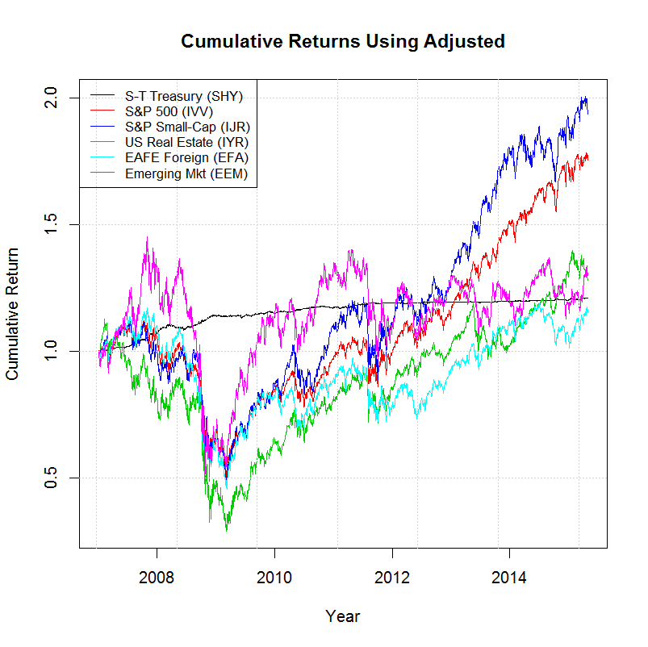
Using quantmod with Close & Adjusted Price
(Yahoo’s Close not adjusted for Splits & Dividends)

Slide 30
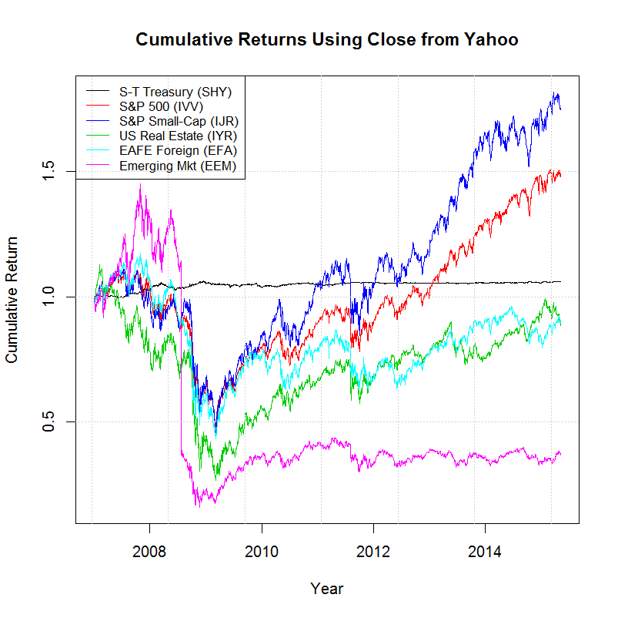
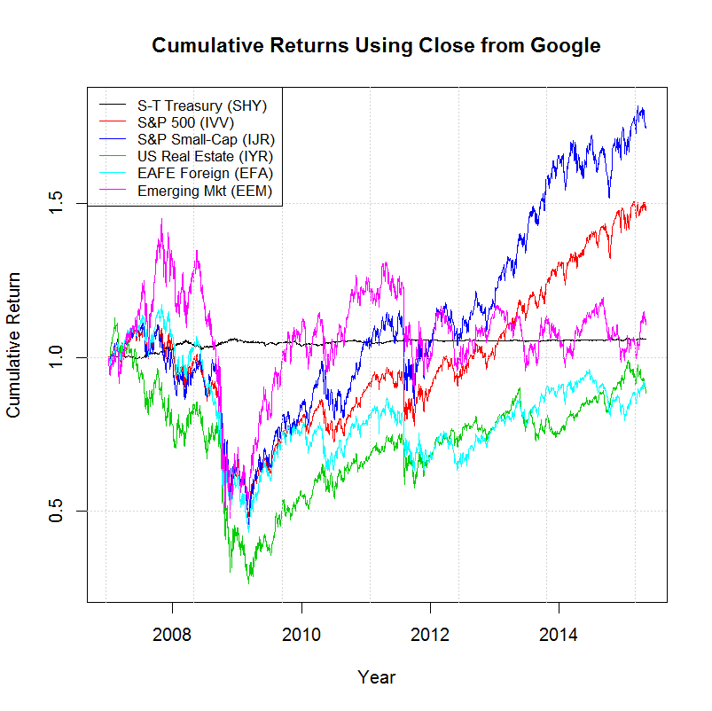
Using quantmod with Close & Adjusted Price
(Google’s Close adjusted for Splits but not Dividends)

Slide 31
Using quantmod with Close & Adjusted Price
(R code)
getSymbolAdj <- function(sym) {
Price <- sym[,6] # 4=Close, 6=Adjusted
Price1 <- as.numeric(Price[1])
return(Price/Price1)
}
library(quantmod)
tckrs <- c("SHY", "IVV", "IJR", "IYR", "EFA", "EEM")
lgnds <- c("S-T Treasury (SHY)", "S&P 500 (IVV)", "S&P Small-Cap (IJR)",
"US Real Estate (IYR)", "EAFE Foreign (EFA)", "Emerging Mkt (EEM)")
getSymbols(tckrs, frm="2007-01-01") # can add src="google"
ETF1 <- getSymbolAdj(SHY)
ETF2 <- getSymbolAdj(IVV)
ETF3 <- getSymbolAdj(IJR)
ETF4 <- getSymbolAdj(IYR)
ETF5 <- getSymbolAdj(EFA)
ETF6 <- getSymbolAdj(EEM)
basket <- cbind(ETF1, ETF2, ETF3, ETF4, ETF5, ETF6)
zoo.basket <- as.zoo(basket)
# Set a color scheme and plot
colors <- c("black", "red", "blue", "green3", "cyan", "magenta")
plot(x = zoo.basket, xlab="Year", ylab="Cumulative Return",
main="Cumulative Returns Using Adjusted", col=colors, screens=1) # 4=Close, 6=Adjusted
# Draw grid lines and set a legend in the upper left hand corner
grid()
legend(x="topleft", legend=lgnds, lty=1, col=colors, cex=0.8)

Slide 32
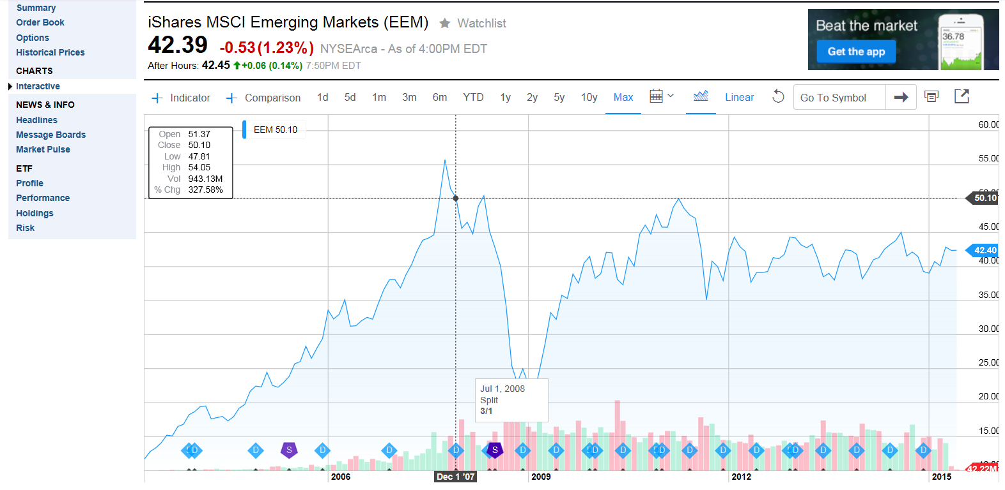
Yahoo Chart Showing Splits & Dividends http://finance.yahoo.com/echarts?s=EEM+Interactive#symbol=EEM;range=my

Slide 33
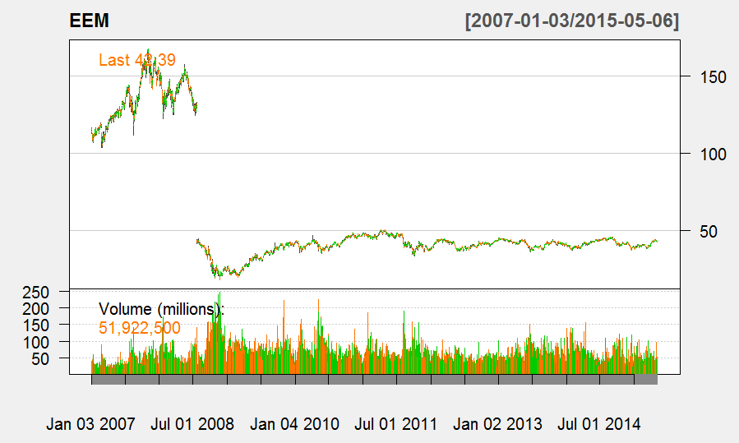
EEM using Quantmod’s ChartSeries chartSeries(EEM, theme=chartTheme('white'))

Slide 34
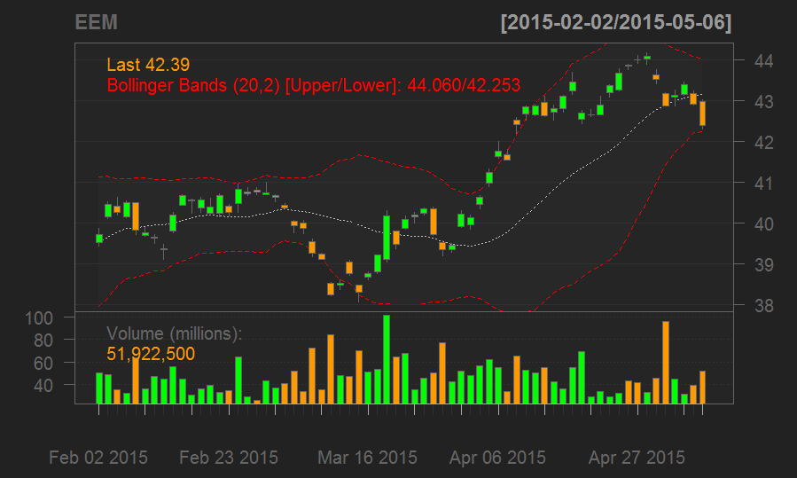
EEM, LAST 4 Months with technical indicators chartSeries(EEM, subset='last 4 months', TA=c(addVo(),addBBands()))

Slide 35
References
http://paulmerriman.com/ (Paul Merriman website)
http://econdataus.com/investing/alloc.htm (other links)
http://econdataus.com/investing/mstar_watch.htm (creating and monitoring watch lists at Morningstar.com)
http://www.r-project.org/ (R Project for Statistical Computing)

Slide 36
Thank You

